Slide 1
EU Foreign Subsidy Regulation (FSR) ICC Sweden Discussion Paper

Slide 2
FSR: a (tax data reporting) barrier to trading in the EU
A significant reporting challenge for businesses and material non-compliance risks
In brief: the EU Foreign Subsidy Regulation (FSR) aims to identify and combat distortions of competition on the EU internal market caused by foreign subsidies akin to the EU concept of state-aid. However, the interpretation of more broadly defined ‘foreign financial contributions’ (FFCs), specifically as it relates to taxes, places a disproportionate burden on businesses who have not benefitted from any such foreign subsidies. It also risks overwhelming the European Commission with unnecessary information.
Uncertain interpretation and application of rules
FFC definition is broad and very unclear, especially in tax context
Significant volume of data to gather and review
May need to report on 3 years of data for entire group of companies; burden increased by very low €1m de minimis
Unique reporting document
New reporting systems and processes may be required for FSR compliance, not aligned to existing reporting cycles
Urgent filing requirement
Notifiable tenders/transactions must receive approval before they can be awarded/close – high commercial risk
Serious penalties for non-compliance
Tender rejected, M&A deal blocked, and/or fines up to 10% of turnover – significant penalties

Slide 3
FSR: a (tax data reporting) barrier to trading in the EU
We would like to work with the European Commission to develop clarifying tax guidelines
We fully support and commend the Commission’s efforts to implement robust rules to ensure the EU internal market is a level playing field for businesses across all sectors.
However, the risk of very significant financial penalties for perceived non-compliance together with broadly drafted rules means that businesses who have not benefitted from such foreign subsidies are being advised, in an abundance of caution, to gather and report data beyond the intended scope of the FSR. This is creating a disproportionate reporting burden for businesses who are not the intended target of the rules and, as a consequence, the European Commission will receive an excessive amount of data.
We propose that the European Commission confirms that tax measures that are generally applicable to all taxpayers and that are part of domestic tax legislation should not be reported. Such general provisions are also often similar to the provisions already found in the tax systems of the EU Member States. Such measures may include, but are not limited to:
Participation exemptions for capital gains and dividend income
R&D tax credits and patent / innovation box regimes
Accelerated tax depreciation for specific categories of capital expenditure
All temporary timing differences
Provisions for loss relief between group companies
We also propose to ask the European Commission to clarify other matters relating to taxes, including:
The application of FSR to indirect taxes,
Whether corporate tax-related FFCs are granted to companies in a loss position, and
How the grant date and value of a tax-related FFC should be determined.

Slide 4
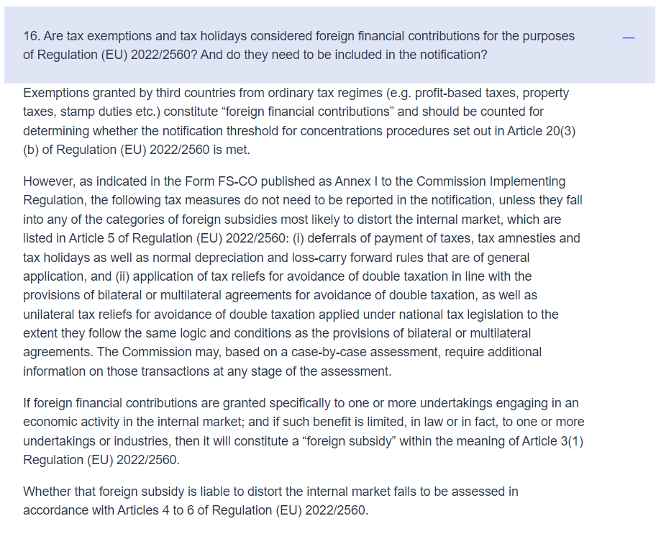
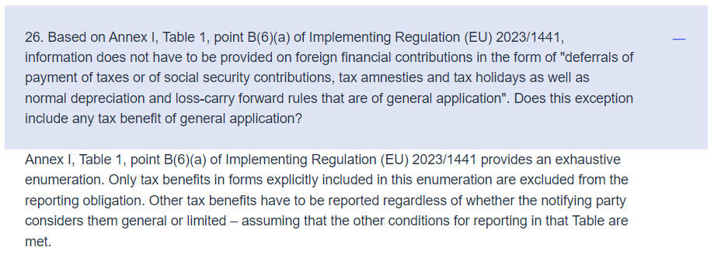
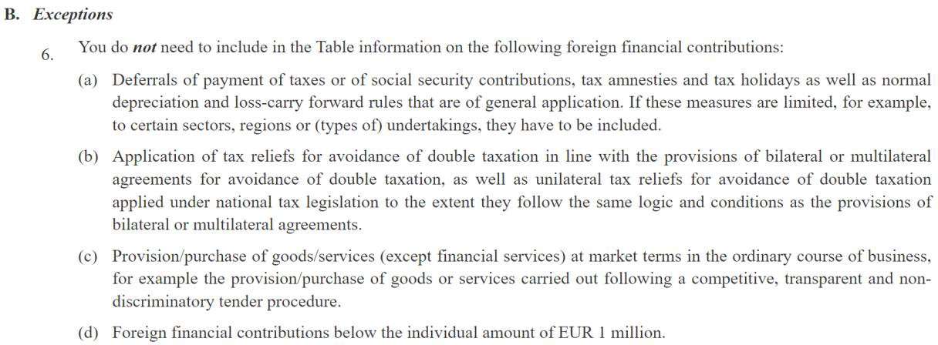
European Commission Q&A clarifications re: tax
Annex I, Table 1, point B(6)(a) of Implementing Regulation (EU) 2023/1441
European Commission Questions and Answers: https://competition-policy.ec.europa.eu/foreign-subsidies-regulation/questions-and-answers_en
Implementing Regulation (EU) 2023/1441: https://eur-lex.europa.eu/eli/reg_impl/2023/1441/oj

Slide 5
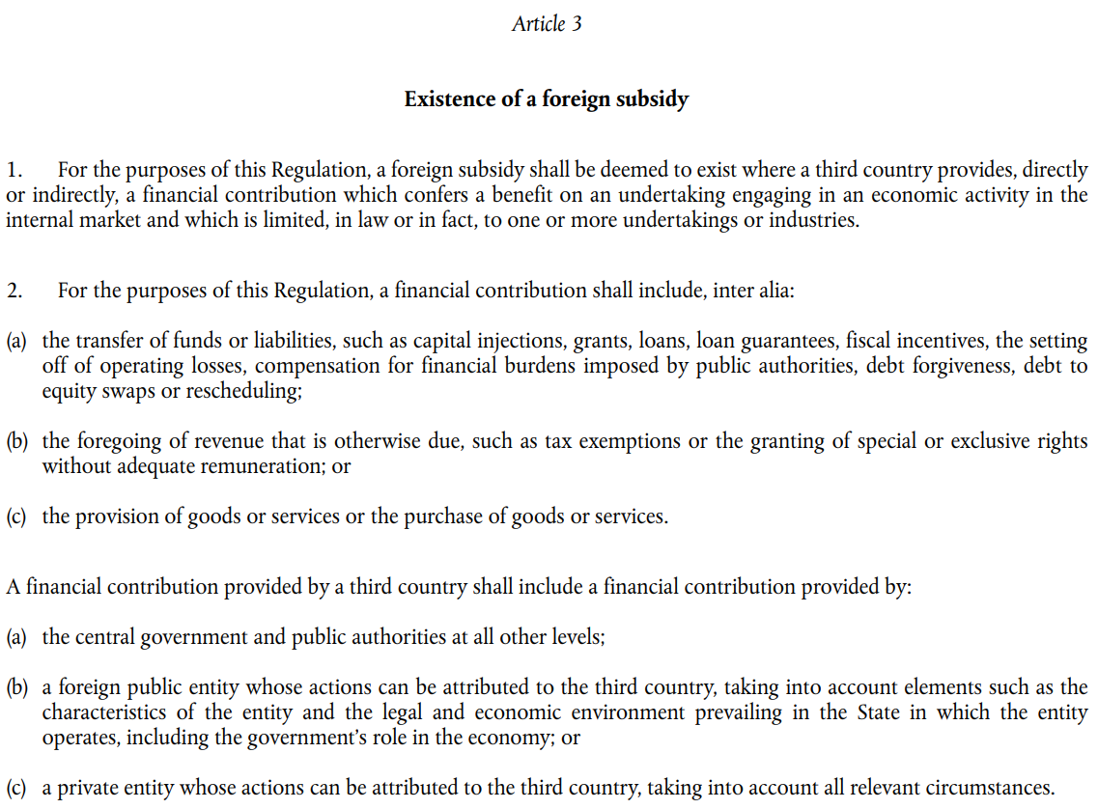
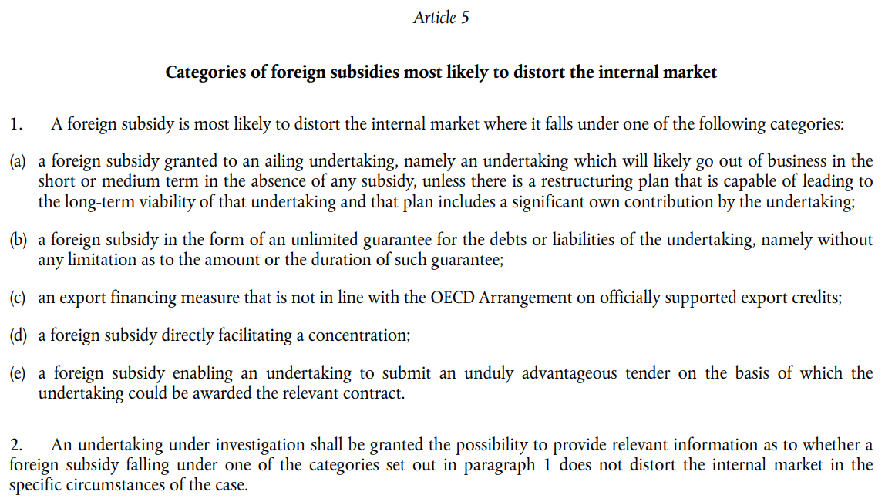
Articles 3 and 5 of Regulation (EU) 2022/2560
European Commission Questions and Answers: https://competition-policy.ec.europa.eu/foreign-subsidies-regulation/questions-and-answers_en
Implementing Regulation (EU) 2023/1441: https://eur-lex.europa.eu/eli/reg_impl/2023/1441/oj

