Slide 1

Digital Services Act Commission Proposal for a Regulation Briefing Call 21 January 2021

Slide 2
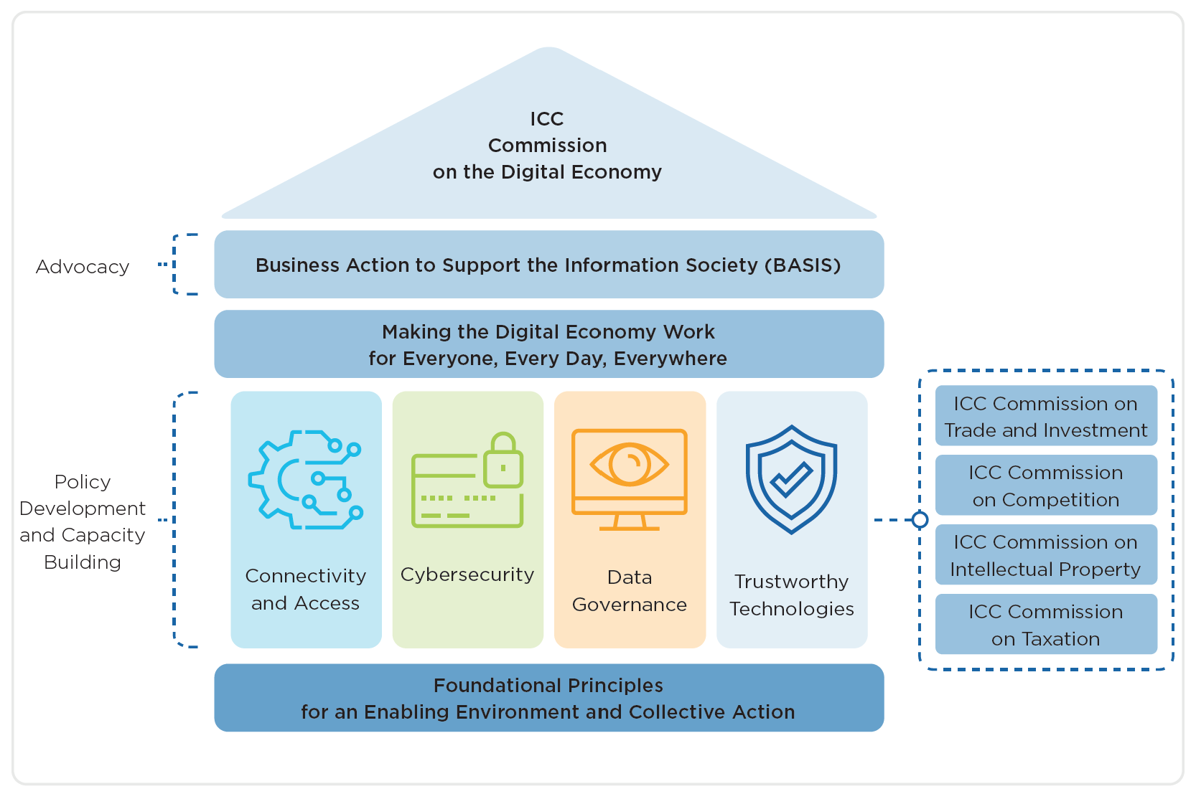
Setting the Scene
The presence of illegal and harmful content online is increasingly eroding trust between digital service providers and users
The increasing use of algorithmic personalisation and other tools to target and tailored content is leading to discussions on the ethical considerations of such practices.
Policy makers have been placing increasing pressure on technology companies to be more transparent and to manage content on their platforms.
Tensions between the local socio-cultural specificities of content and the global nature of the Internet is leading to fragmentary dynamics and the balkanisation of the global network.

Slide 3
Background
eCommerce Directive (2000) - (i) promote e-commerce in the EU, (ii) prevent illegal content on the Internet and, (iii) protect EU fundamental rights
The Safe Harbour principle exempts from liability “information society service” providers who transmit or host content produced by a third party under certain conditions
Hosting providers are subject to 'duties of care' and 'notice and take down' obligations
The Directive prohibits Member States from imposing general obligations of monitoring
The Directive also clarifies that the Internal Market’s country of origin principle must be applied to information society services.

Slide 4
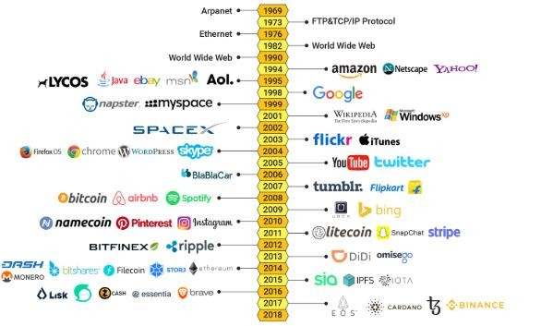








Background
E-Commerce Directive adopted in the EU

Slide 5
Background
On 19 February 2020, President von der Leyen and the European Commission (EC) set out its strategy for the Digital Single Market in Shaping Europe's Digital Future
Objective of the Digital Services Act
Modernise the rules governing digital services across the EU, ensuring that SME platforms can scale up across the Single Market;
Clarify liability concepts, with clear responsibilities, transparency and accountability, to make the internet safer for users and offer a regulatory model to third countries that balances safety and security with fundamental rights and freedoms;
Increase accountability and facilitate better oversight and effective and responsive administrative cooperation between competent authorities in the Member States
On 15 December 2020, the EC published proposals for two legislative initiatives: the Digital Services Act (DSA) and the Digital Markets Act (DMA)

Slide 6
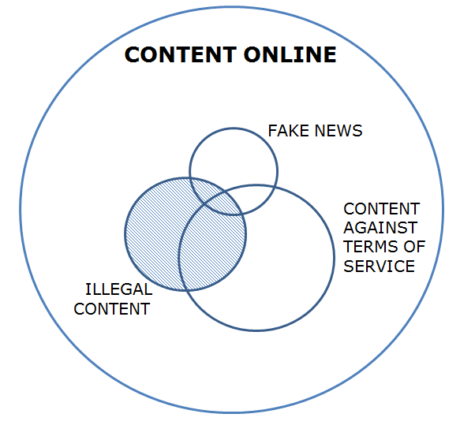
General Provisions
The proposal maintains the limited liability rules for providers of intermediary services and sets out the conditions under which service providers are exempt from liability for the third party information they transmit and store
The proposal also maintains the prohibition of general monitoring or active fact-finding obligations for those providers
Building on the eCommerce Directive, the proposal
introduces new obligations for providers of intermediary services
entrusts regulators with new oversight and enforcement prerogatives
Creates new rights and obligations for all businesses that participate in the Digital Single Market.
HARMFUL CONTENT

Slide 7

Obligations for All Online Intermediaries
Designate a single point of contact or a legal representative in the EU for all communications with the National Digital Services Coordinators, the European Board for Digital Services and the European Commission
Publicise clear terms and conditions on any policies, procedures, measures and tools used for the purpose of content moderation, including algorithmic decision-making and human review
Publish annual transparency reports
Engage with national judicial or administrative authorities in the context of orders to act against illegal content and orders to provide information
Online intermediaries
Hosting services
All platforms
Very large
platforms

Slide 8
Additional Obligations Hosting Service Providers
Online intermediaries
Implement harmonized rules for notice-and-action mechanisms that allow any individual or entity to notify the presence of information that the individual or entity considers to be illegal content
Provide a statement of reason whenever a provider decides to remove or disable access to specific items of information
Hosting services
All platforms
Very large
platforms

Slide 9
Additional Obligations for Online Platforms
Provide an internal complaint-handling system that enables users to challenge the decisions taken by the online platform to remove or disable information
Engage in good faith with out-of-court settlement bodies that have been certified by DSCs
Ensure that notices from “trusted flaggers” are processed and decided upon with priority
Suspend for a period of time and after having issued a prior warning, users that frequently provide manifestly illegal content
Notify law enforcement authorities of suspicions of criminal offences
Ensure the adequate traceability of traders when the platform allows consumers to conclude distance contracts with traders
Provide additional information in annual transparency reports, including information relating to online advertising
Online intermediaries
Hosting services
All Platforms
Very large
platforms

Slide 10
Additional Obligations for Very Large Online Platforms
Produce an annual risk assessment report to identify, analyse and assess systemic risk
Implement reasonable, proportionate and effective mitigation measures
Engage in an annual independent audit to assess compliance under the provisions of the proposal
Include information on recommender systems in the terms and conditions
Make publicly available a repository with specific information on advertising practices
Provide DSCs with data that is necessary to monitor and assess compliance
Appoint one or more compliance officers
Abide by specific transparency requirements, including bi-annual transparency reports
Online intermediaries
Hosting services
All platforms
Very large
platforms

Slide 11




DSA Private Sector Stakeholders
Digital Service Providers
Online Traders
Online Content Creators
Rights
Holders
EU-wide exemption of
liability
Harmonized rules across the EU
Rules proportionate to size and impact
Additional Transparency and due diligence requirements
Financial penalties in case of non-compliance
Co-regulatory processes, guidance and standardisation, to facilitate compliance
Harmonized statements of reasons when specific items are removed
Internal complaint-handling systems to challenge decisions
DSC certified out-of-court dispute settlement bodies
Traders must provide information for traceability purposes
Harmonized statements of reasons when specific content is removed
Internal complaint-handling systems to challenge decisions
More information on how content is removed, ranked and advertised
Specific provisions for increased online advertising transparency
Promotes Codes of Conduct for online advertising
Harmonized Notice-and-Action mechanisms
Trusted flagger status under certain conditions
Complaint mechanisms when notices are not followed
More information on how content is removed, ranked and advertised
Risk mitigation measures by very large online platforms
Traceability of traders
Digital Service Providers
Users

Slide 12



Governance Structure
Digital Service Coordinators
Board for Digital Services
European Commission
Independent authorities
Coordination with other national competent authorities
Coordination and cooperation at EU level with the Board, EC and other DSCs
Investigatory powers and ability to impose fines and penalties
Can receive complaints from individuals and entities
Ad-hoc independent advisory group
Composed by DSCs, chaired by EC
Advises DSCs and EC, recommending actions
Acts are non-binding but must be taken into account
Cooperation with other EU bodies and agencies on related matters
Administrative support to the Board
Advises on cross-border disputes
Intervenes upon DSC request
Direct enforcement powers for very large online platforms and if DSCs fail to act
Investigatory powers and ability to impose fines and penalties
Digital Service Providers
Users

Slide 13
Next Steps
European Parliament and the Council of the European Union will assess the proposed Regulation in the context of the co-decision process.
The European Commission is currently open for feedback on the proposal until March 3. We highly encourage members to provide comments on the proposal here.
ICC will provide support and guidance throughout the upcoming process. We will aim to regularly inform members on the evolution of the discussions, and, more importantly, create opportunities for members to engage directly with policy makers.
ICC Secretariat is looking to provide members and National Committees with an opportunity to engage with DG CNECT during a second roundtable discussion.
We welcome your input to identify specific topics of interest and consolidate salient questions that we can include in the roundtable discussion.

Slide 14
THANK YOU!
Contact Details - Innovation for All Hub
Sophie Peresson, Director
sophie.peresson@iccwbo.org
Charly Gordon, Deputy Director
charly.gordon@iccwbo.org
Timea Suto, Knowledge Manager
Timea.suto@iccwbo.org

